Slide 1

National Institute of Technology Patna
Department of Computer Science and Engineering
MINOR PROJECT​
on​
DIABETIC RETINOPATHY
DETECTION​
(Jan-Jun, 2021)
Presented by:​​
RIYA KUMARI (1806007)​​
ARUNIKA SHEETAL(1806021)​​
BABITA KUMARI(1806029)
Under the Supervision of:​​
Dr. RAJIB GHOSH
(Assistant Professor Grade-I)

Slide 2


ABSTRACT
In this project, we are working on the automatic detection system for Diabetic Retinopathy using deep learning techniques. Our network uses CNN to identify different features on the retina. Our models were developed using Tensorflow, an open source library for machine learning. We have trained this network using kaggle dataset.

Slide 3
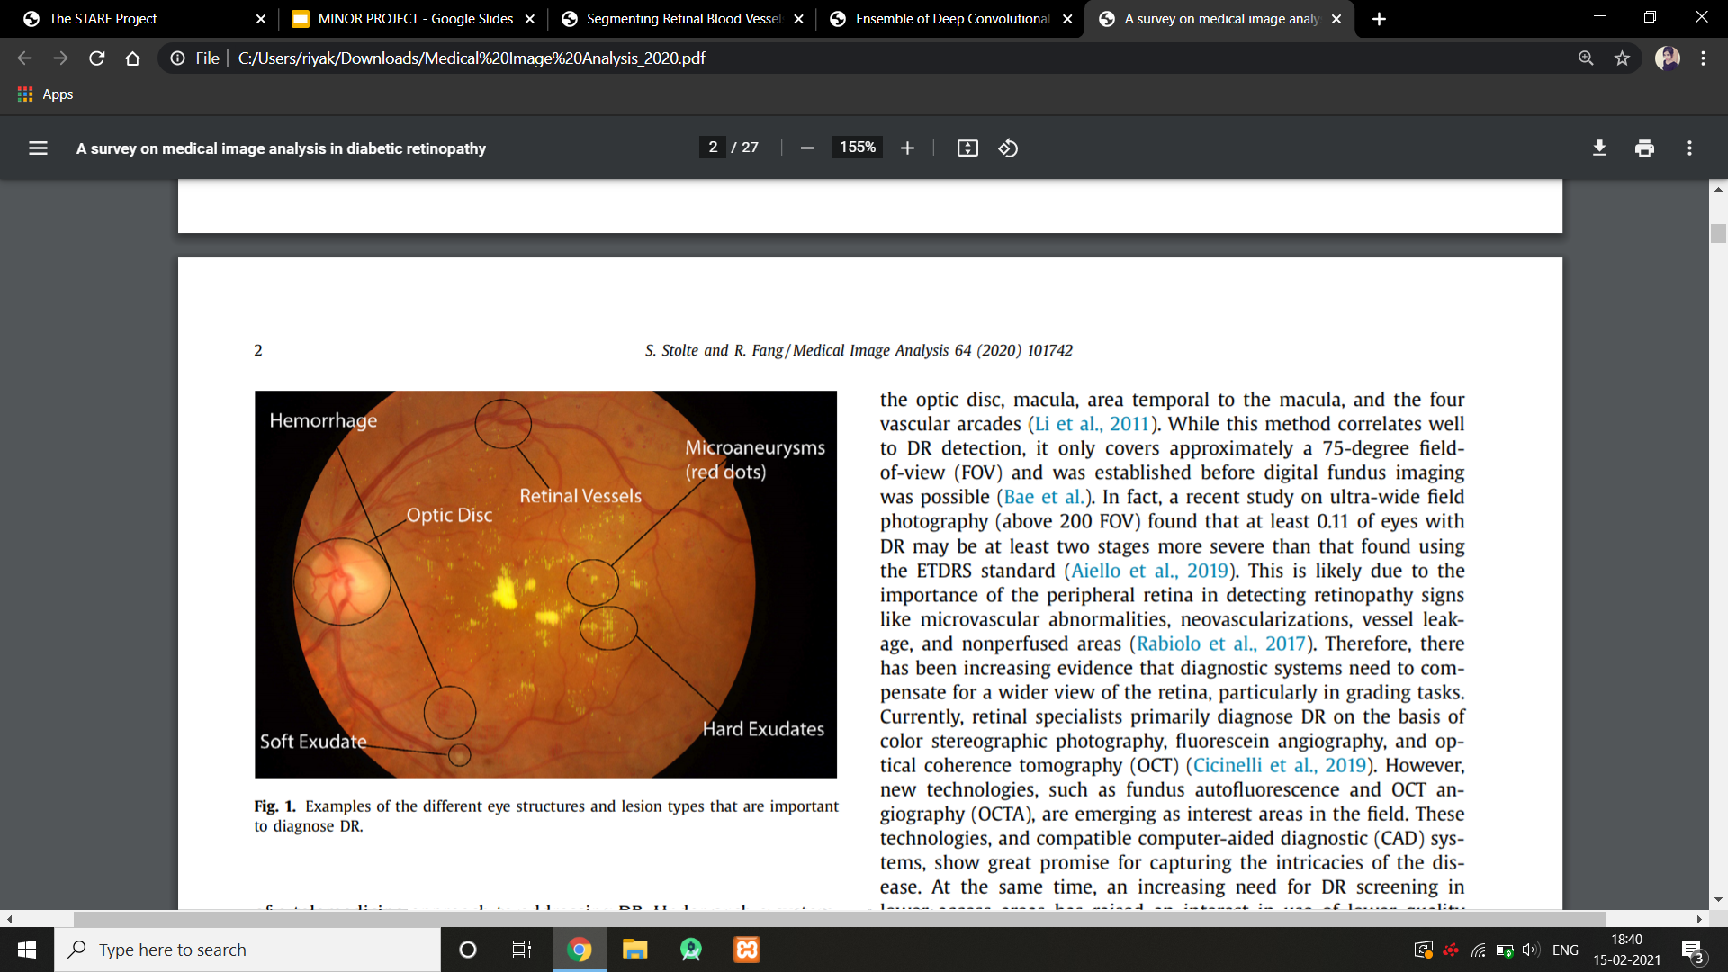
INTRODUCTION
DR is an eye disease that damages the retina of an eye due to long-standing diabetes. It is considered as a leading cause of blindness in the world.
DR have different abnormal effects on the retina e.g.,microaneurysms, hard and soft exudates, hemorrhages and macular edema.
The symptoms include blurred vision, large floaters, distorted central vision, blind spots and sudden loss of vision.

Slide 4
DATASET
KAGGLE DATASET (2019)
The images consist of retina scan images to detect diabetic retinopathy. The original dataset is available at APTOS 2019 Blindness Detection. These images are resized into 224x224 pixels so that they can be readily used with many pre-trained deep learning models.
All of the images are already saved into their respective folders according to the severity/stage of diabetic retinopathy using the train.csv file provided.
SEE THE DATASET WITH POSITIVE AND NEGATIVE IMAGES
->>>>>>NEXT PAGE

Slide 5
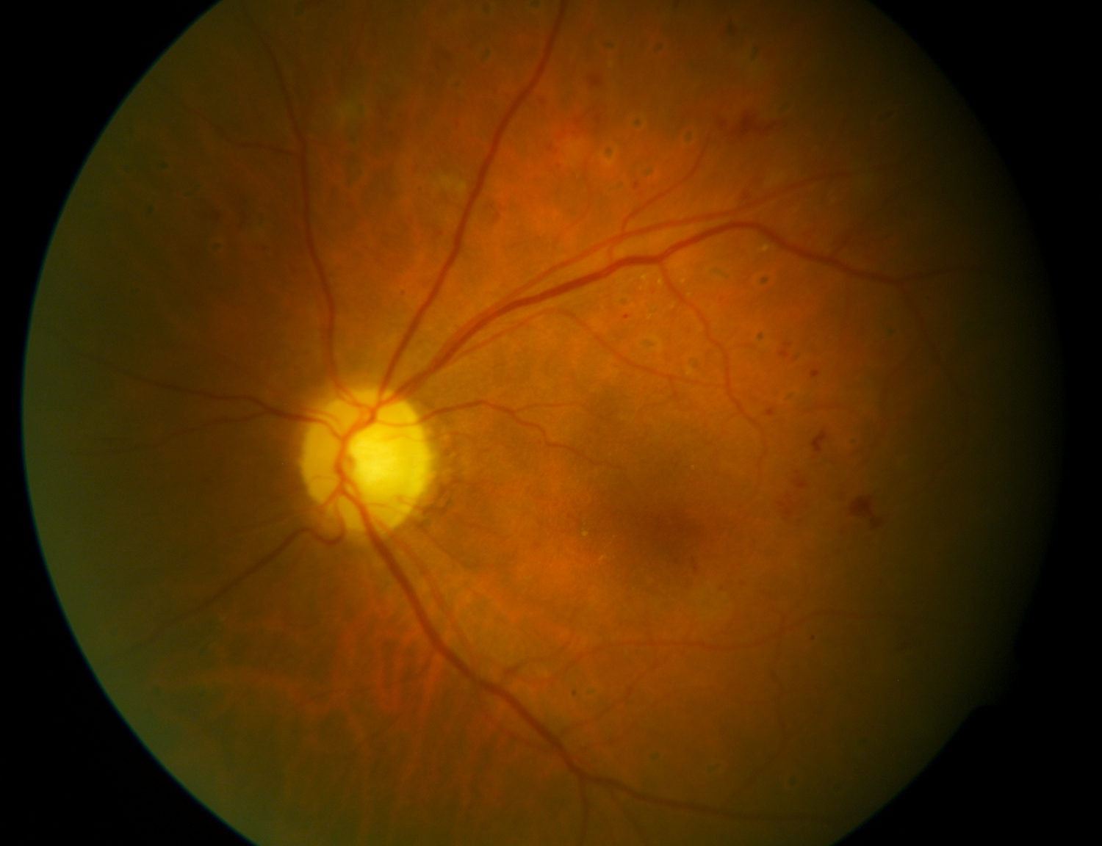
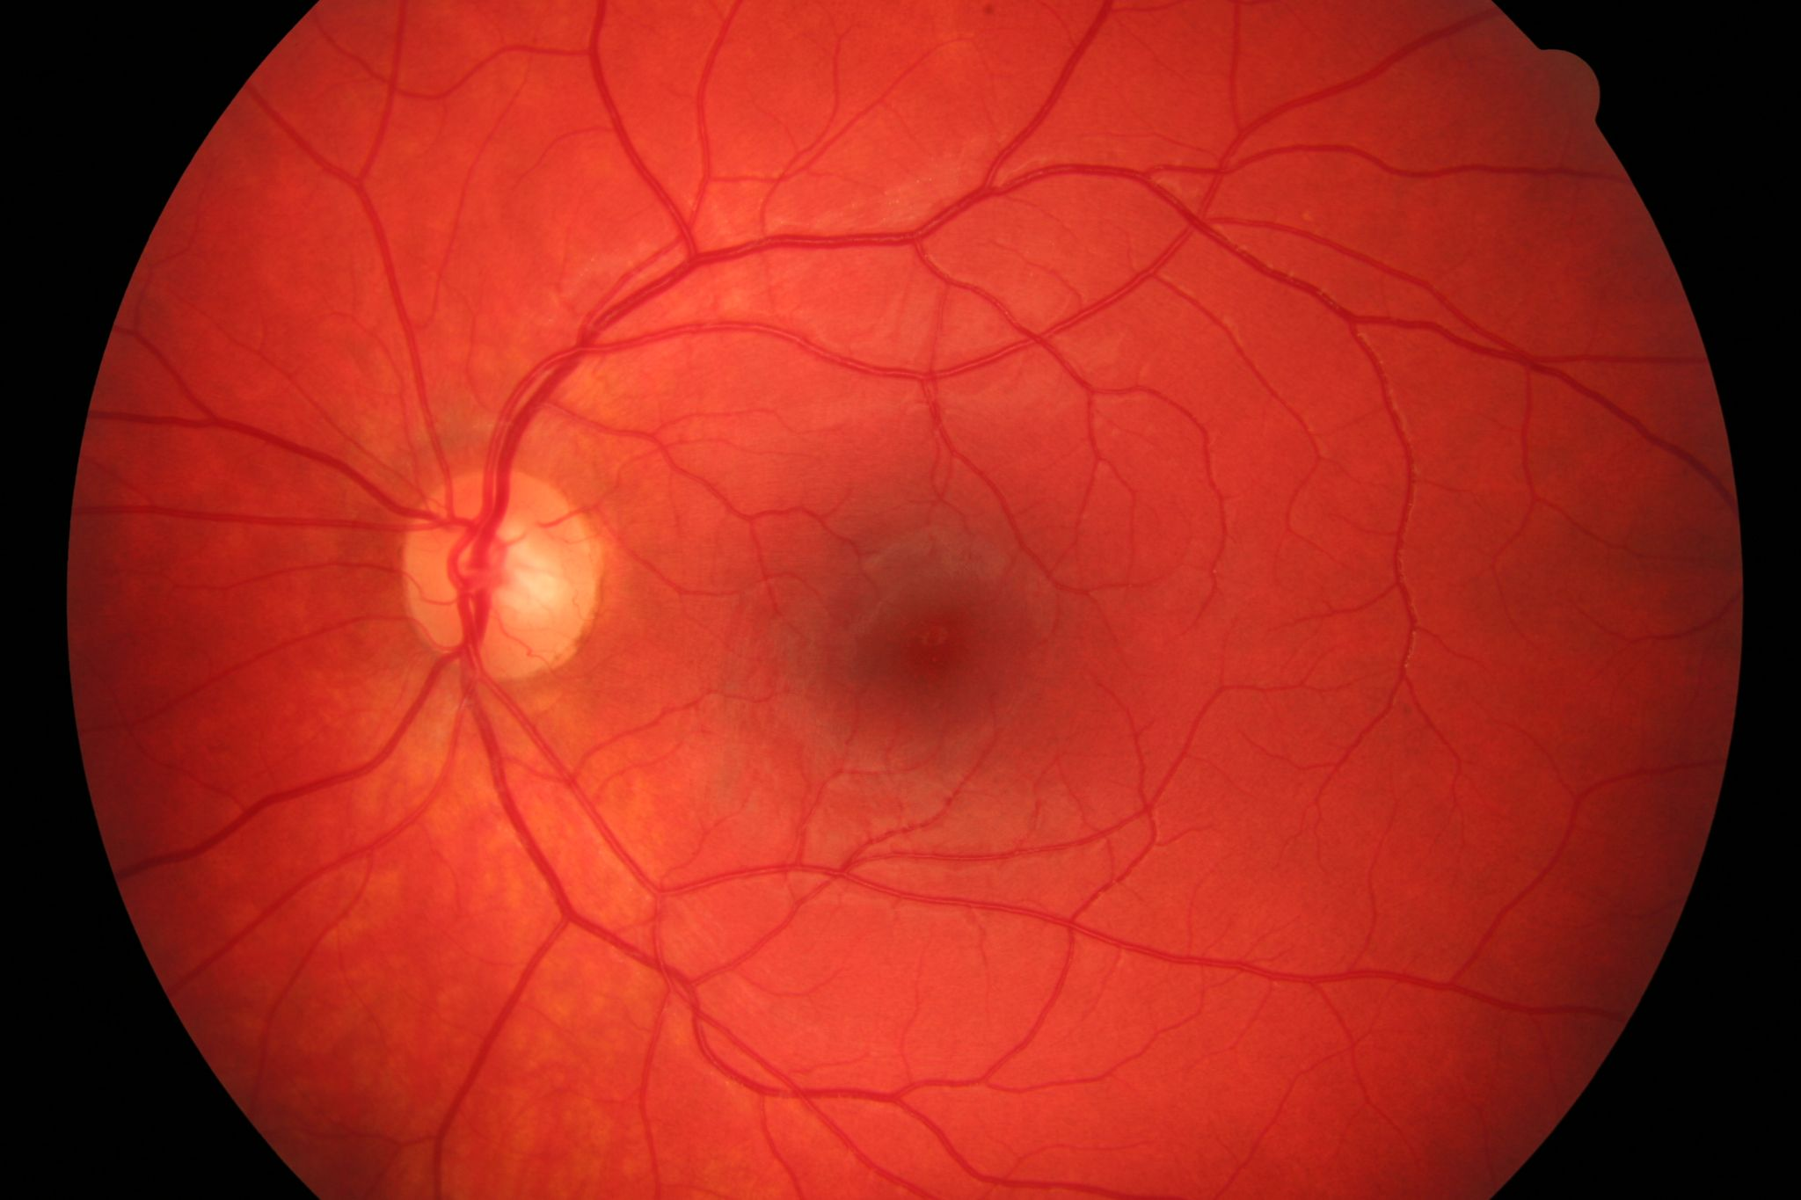
DEFECTED EYE
NORMAL EYE

Slide 6
METHOD : CONVOLUTIONAL NEURAL NETWORK
LIBRARIES USED:
from sklearn.model_selection import train_test_split
from keras.preprocessing.image import ImageDataGenerator
import matplotlib.pyplot as plt
from tensorflow.keras.regularizers import l2
from keras.callbacks import ReduceLROnPlateau, EarlyStopping

Slide 7
WHY CONVOLUTIONAL NEURAL NETWORK ?
DIABETIC RETINOPATHY IS A LEADING PROBLEM THROUGHOUT THE WORLD AND MANY PEOPLE ARE LOSING THEIR VISION BECAUSE OF THIS DISEASE. THE DISEASE CAN GET SEVERE IF IT IS NOT TREATED PROPERLY AT ITS EARLY STAGES. THE DAMAGE IN THE RETINAL BLOOD VESSEL EVENTUALLY BLOCKS THE LIGHT THAT PASSES THROUGH THE OPTIC NERVES WHICH MAKES THE PATIENT WITH DIABETIC RETINOPATHY BLIND. THEREFORE, IN OUR RESEARCH WE WANTED TO FIND OUT A WAY TO OVERCOME THIS PROBLEM AND THUS USING THE HELP OF CONVOLUTIONAL NEURAL NETWORK (CONVNET), WE WERE ABLE TO DETECT MULTIPLE STAGES OF SEVERITY FOR DIABETIC RETINOPATHY.

Slide 8
IMAGE PRE PROCESSING
RGB to GRAY image
CLAHE
RGB to HSV
Masking

Slide 9
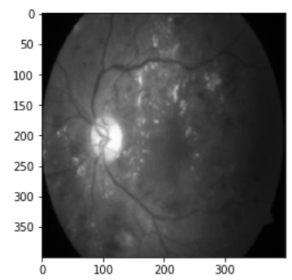
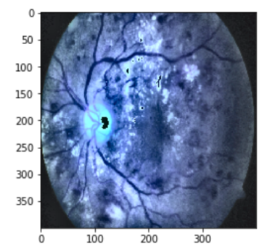
GRAY SCALE
TRANSFORMATION:
CLAHE ENHANCEMENT:

Slide 10

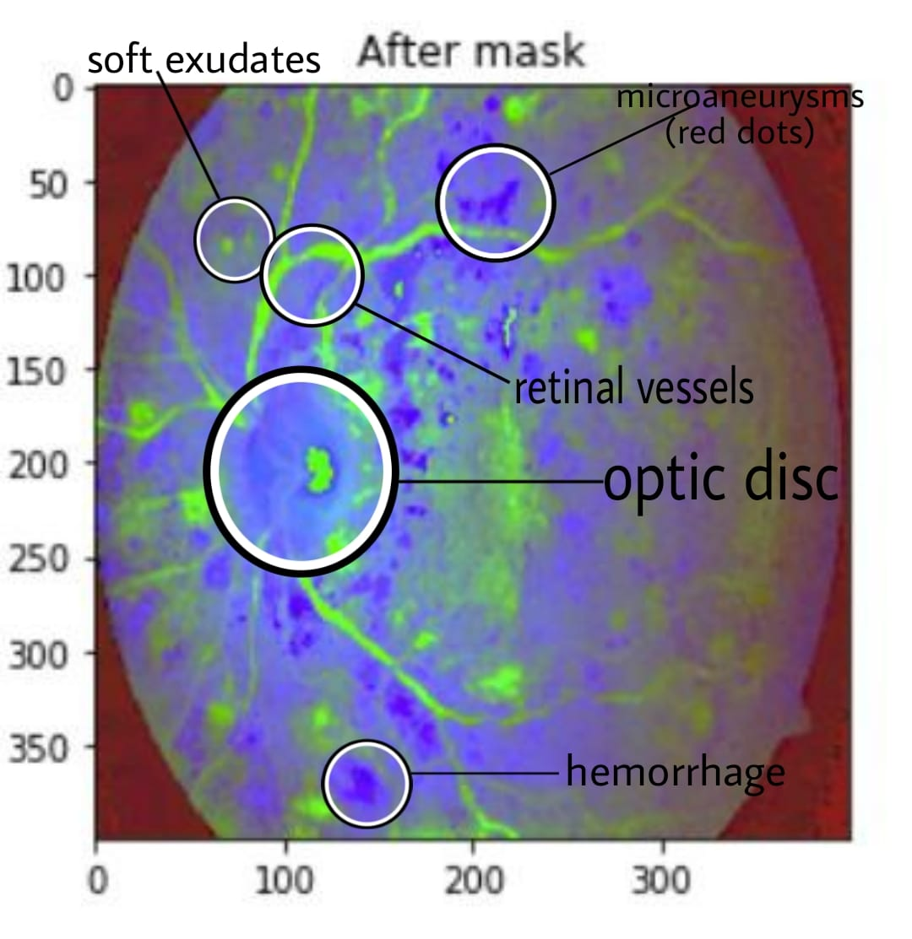
AFTER
IMAGE PRE PROCESSING

Slide 11
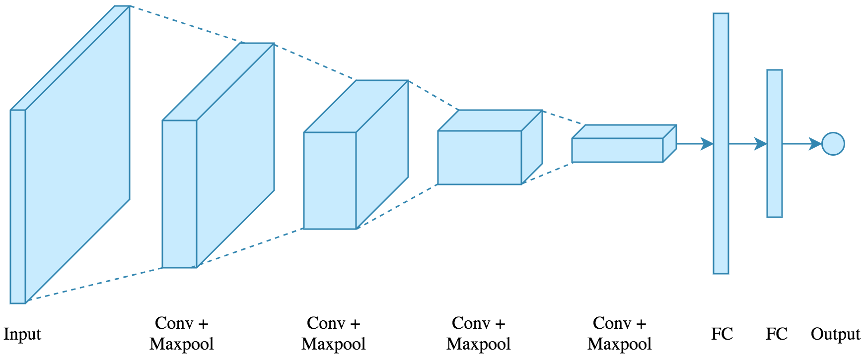
CNN ARCHITECTURE

Slide 12
MODEL
No. Of CNN layers = 4 (16, 32, 32, 32)
No. Of max pooling layers = 4
No. Of dense layers = 2 (size:128, 64)
Firstly, A convolutional 2D layer with 16 layers, and the input size is 224*224*3 is added.
A convolution is a linear operation that involves the multiplication of a set of weights with the input. The multiplication is performed between an array of input data and a two-dimensional array of weights, called a filter or a kernel. The filter is smaller than the input data and the type of multiplication applied between a filter-sized patch of the input and the filter is a dot product. The output of one time multiplication is a single value.

Slide 13
The activation function here is LeakyReLU(alpha=0.1).
After that, we’ve added a max pooling layer that halves the image dimension, so that after this layer, the output is 112*112*3.
Max pooling selects the brighter pixels from the image. It is useful when the background of the image is dark and we are interested in only the lighter pixels of the image.
Then we’ve added 3 more of these layers together, with different filters in CNN.
Finally, the CNN layer is flattened and sent to the output layer
The activation function here is softmax activation function.

Slide 14
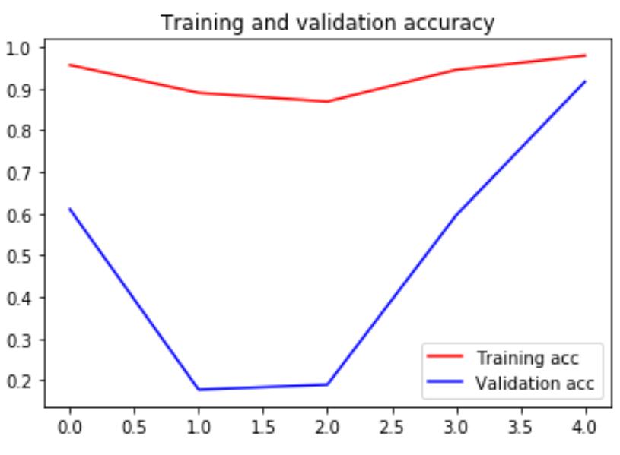
RESULT
Validation
Accuracy = 0.916
Training
Accuracy = 0.972

Slide 15
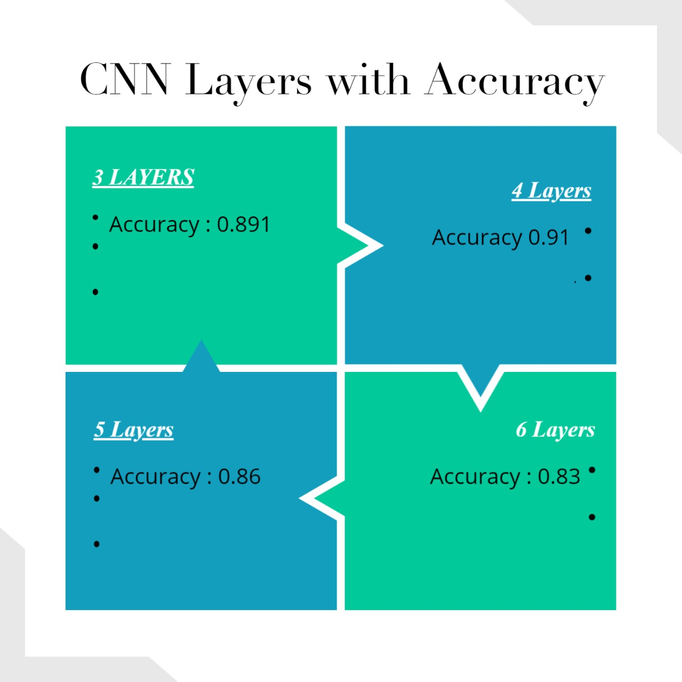
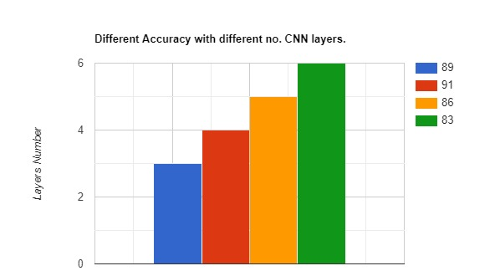
ACCURACY with DIFFERENT LAYERS

Slide 16
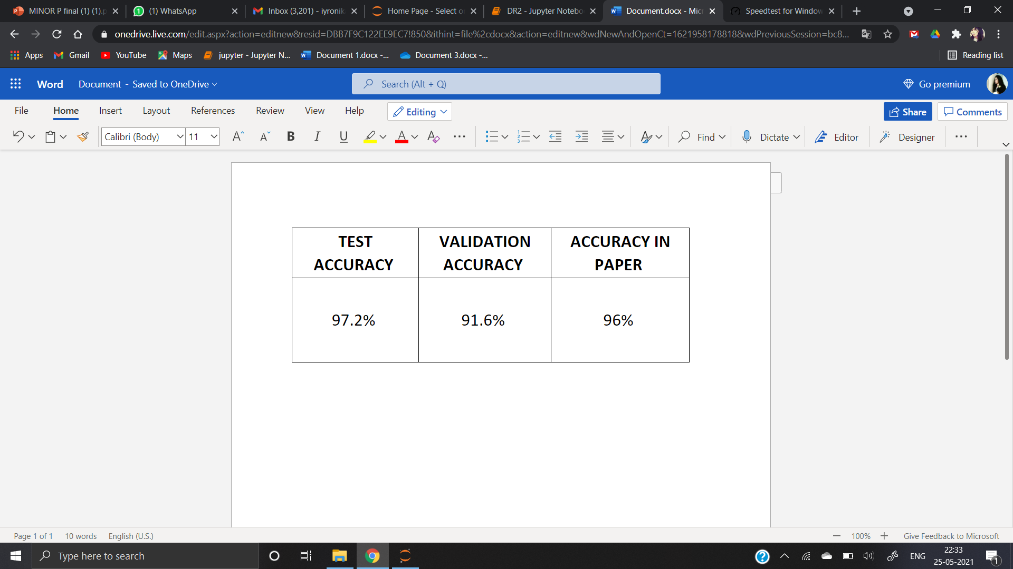
COMPARISON with IEEE PAPER
Diabetic Retinopathy Detection using Deep Learning,
IEEE transactions on medical imaging,
Supriya Mishra; Seema Hanchate; Zia Saquib

Slide 17
CONCLUSION
This project presents the implementation of deep convolutional neural networks for automatic detection and classification of diabetic retinopathy from color retinal images. To avoid overfitting, we have used different methods like early stopping, and L2 regularizer. We have implemented the diabetic retinopathy detection module with different number of convolutional layers for different models amongst which the one with 4 layers gave the best accuracy.

Slide 18
REFERENCES
[1] Pawe l Liskowski and Krzysztof Krawiec. Segmenting retinal blood vessels with deep neural
networks. IEEE transactions on medical imaging, 35(11):2369–2380, 2016.
[2] Kevis-Kokitsi Maninis, Jordi Pont-Tuset, Pablo Arbel´aez, and Luc Van Gool. Deep retinal image understanding. In International Conference on Medical Image Computing and Computer-Assisted Intervention, pages 140–148. Springer, 2016.
[3] Aaron Wu, Ziyue Xu, Mingchen Gao, Mario Buty, and Daniel J Mollura. Deep vessel tracking: A generalized probabilistic approach via deep learning. In Biomedical Imaging (ISBI), 2016 IEEE 13th International Symposium on, pages 1363–1367. IEEE, 2016.
[4] Avijit Dasgupta and Sonam Singh. A fully convolutional neural network based structured prediction approach towards the retinal vessel segmentation. In Biomedical Imaging (ISBI2017), 2017 IEEE 14th International Symposium on, pages 248–251. IEEE, 2017.

Slide 19
THANK YOU!

